Slide 1
COOLSPACES 4 LIFE (LIFE20 CCM/PL/001607)
PROJECT LOCATION: Wrocław, Poland
Warszawa, Poland
Almería, Spain
Abanto y Ciérvana, Spain
BUDGET INFO:
Total amount: 2,892,623 Euro
% EC Co-funding: 55
DURATION: Start: 01/09/21 - End: 31/08/26
PROJECT’S IMPLEMENTORS:
Coordinating Beneficiary: Wrocław University of Science and Technology
Associated Beneficiaries: PROZON The Foundation for Climate Protection
Universidad de Almería
HEDERA HELIX S.L.
Warszawa
Wrocław
Abanto y Ciérvana
Almería
prof. Sabina Rosiek-Pawłowska
Project PI
Notes:
titre

Slide 2
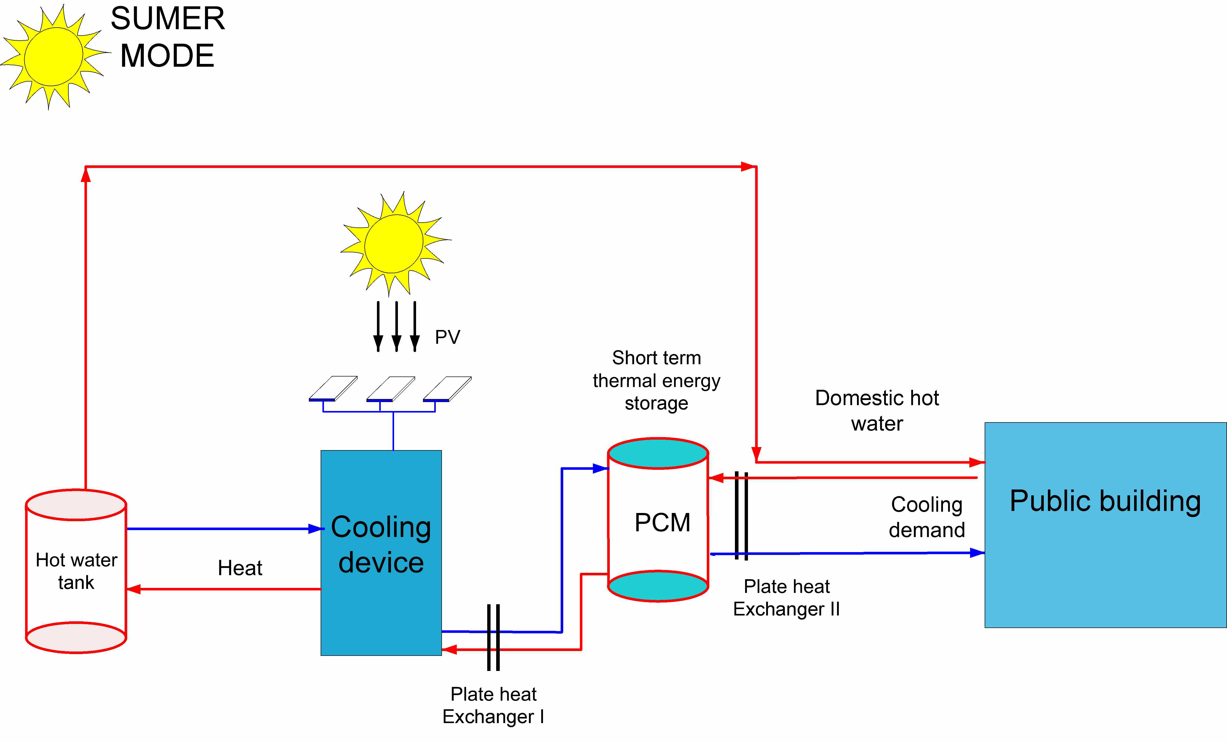
PROJECT’S HIGHLIGHTS
COOLSPACES for the first time will study a solar-powered system that employs a newly designed CFR-based cooling prototype, a photovoltaic electricity production system and PCM-based tanks working in tandem.
Two selected EU locations (Poland and Spain) - aiming to study the system applicability under different climatic conditions.
Focus on demonstrating the technical and cost reliability and performance.
prof. Sabina Rosiek-Pawłowska
Project PI
……………
[Logo(s)]
Notes:
titre

Slide 3
OBJECTIVES & SCOPE
Reduction of greenhouse gas emissions by reducing the consumption of primary, non-RES energy used by air conditioning systems.
Reduction of greenhouse gas emissions by using refrigerants with a negligible Global Warming Potential (GWP).
The search for the most suitable heat storage material to bridge the mismatch between renewable energy supply and energy consumption.
The optimization, control and metering of solar-powered CFRs-based BC system, ensuring decreased annual electricity consumption.
Demonstrating the potential of solar-powered BC systems around the Europe.
Application of Life Cycle Assessment (LCA) and Life Cycle Costing (LCC) analysis as instruments for policy support.
prof. Sabina Rosiek-Pawłowska
Project PI

Slide 4
EXPECTED IMPACTS
Reduction of GHG emissions
Improvement of air quality
Better use of energy
Awareness raising
CO₂: ~41 tons/year
HFC: ~10.6 tons CO₂ eq.
Be a useful tool to effectively and timely diminish the local air pollution and carbon footprint, improving urban living standards
~52 MWh/year
~40 MWh/year
We hope to inspire people and make them realize that a sustainable system for institutional buildings is not one of scarcity and limitations. It can be a great way to conserve resources, pollute far less, use CFRs and clean energy from renewable sources, and think carefully about how we produce and consume.
prof. Sabina Rosiek-Pawłowska
Project PI

Slide 5
POLICY IMPLICATIONS
COOLSPACES enhances the EU's Sustainable Development Strategy by bringing together four goals: combating climate change, boosting renewable energy, safeguarding the environment and making cities sustainable.
The use of low GWP refrigerants and a reduction in primary energy consumption in buildings directly translate into lower gaseous pollutant emissions (in line with the Clean Air Policy Package and Directive (EU) 2016/2284). COOLSPACES makes it possible to use thermal energy for cooling purposes, combining the advantages of heat source coherence in relation to cooling needs, reducing peak electricity consumption and effectively managing the energy taken from renewable energy systems.
COOLSPACES is consistent with the Montreal Protocol and the Kigali Amendments, which set limits on F-gas emissions. The project responds to the requirements of Regulation (EU) No 517/2014, which sets an HFC reduction target of 79% by 2030.
As part of the project’s initiative in Poland meetings with the Inspectorate of Environmental Protection and the Marshal's Office of the Lower Silesia Voivodship are planned to identify and present the profits resulting from the implementation of project solutions in the area of Wrocław. In Spain, the results will be shared with the local and regional authorities in Science, Education, and the head of the office for CCM in Almería.
prof. Sabina Rosiek-Pawłowska
Project PI

Slide 6
CONTINUATION
We plan to replicate the described technology by selling a non-exclusive license of the innovative cooling device based on climate-friendly refrigerants and thermal energy storage for use in the European Union. Technology transfer will be also possible to other industries that use refrigeration equipment.
Information regarding the installation’s current operation will remain available both on the website and on social networking accounts assigned to the project.
To realize and maintain the COOLSPACES impact in EU countries we will follow the „After-LIFE Plan” prepared within the project.
The resulting installations will continue to be maintained for many years after the project concludes, thus enabling students and visitors, etc. to get to know these pioneering and innovative solutions, providing an excellent experimental set-up with many scientific and teaching possibilities.
After the project ends, the beneficiaries will take an active part in trade fairs and scientific conferences, where the project results will be disseminated in order to attract a new group of recipients and potential license package purchasers.
We will put an effort to ensure national and/or EU funding for replication and technology transfer activities’ continuation.
prof. Sabina Rosiek-Pawłowska
Project PI

